Slide 1
Foster Elementary School Title I Parent/Guardian Orientation November 2, 2018 8:30 – 9:00pm
“Alone we can do so little; together we can do so much.” –Helen Keller

Slide 2
Agenda
Welcome and Introductions – Dr. Wilcox, Principal
Title 1 Program Overview – Julie Quinn, Cori Trombly, and Jen Quirk, Title I Tutors

Slide 3
What is Title I?
Title I is the largest federal aid program for elementary, middle, and high schools. Title I offers grant money to school districts around the country based primarily on census poverty estimates and the cost of education in each state.
Foster and Hingham Middle School are the two Title I schools in Hingham this year.
Grant money is adjusted each year
Title I districts are audited to ensure funds are used appropriately

Slide 4
Title I
Title 1 develops and provides programs aimed at supporting/supplementing regular classroom instruction for identified students who could benefit from extra support in meeting grade level expectations.

Slide 5
Title 1 and Special Education
Title 1
Special Education
Title 1 is supplemental
Fluid program - designed for students to enter and exit out of the program
Does not require an individualized education plan (IEP)
Funded by a Federal Grant
Requires an individualized education plan that lasts for a set amount of time
Working on skills specific to that individual
Funded and governed at the local, state, and federal level.
Legally binding contract

Slide 6
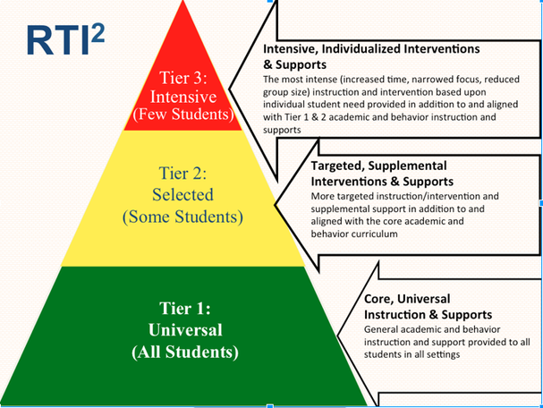
Intervention: The Three Tier Model
Tier 1: Core classroom instruction - all students
Tier 2: Tier 1 + 2
Core classroom instruction + intervention – some students receive additional instruction in reading and math and frequent progress monitoring
Tier 3: Tier 1 + 2 + 3
More intensive instruction that students receive if not making adequate progress in Tiers 1 and 2

Slide 7
How is my child referred to the program?
June – classroom teachers complete a referral form
September – current teacher submits any new referrals
September – testing - Title I and classroom assessments
End of September – data meeting – Dr. Wilcox, Title I Tutors, grade level classroom teachers, and the special education teacher meet together to discuss those referred
Permission slips are sent home
October – Reading and math groups begin
Throughout the year – groups are monitored and reassessed
Students may enter and exit the program at any time

Slide 8
Testing and Teacher Recommendation Initial testing – then students are continuously monitored for progress
Teacher Recommendation
Classroom assessments
NWEA
Literacy
Mathematics
Teacher Recommendation
Classroom assessments (developmental spelling, running records)
DIBELS
NWEA

Slide 9
Title I Math and Reading at Foster
Response to Intervention (RTI) – English language arts support for grades 1 – 3
30 minutes, 4 x per week
Targeted Math Instruction (TMI) –
math support for grades 1 – 5

Slide 10
Where Does my Child Receive Instruction?
All instruction takes place in small groups
Small groups meet either in the Title 1 room, the classroom, or a small group space
Students in Title I work with well-trained instructors who present direct, intensive lessons based on the skills in which your child needs more support.
*Instructors meet every week to discuss progress, monitor groups, and plan for the up-coming week.

Slide 11
What Curriculum is being used?
Mathematics
Everyday Math
Supplemental resources & materials
IXL
Literacy
Journeys – reading program (Houghton Mifflin Harcourt)
Fundations sound cards (Wilson)
Lexia Core 5

Slide 12
HOW CAN FAMILIES SUPPORT THEIR CHILDREN AT HOME?
Suggested Homework:
Lexia, 3 x 20 minutes per week
IXL, 2 x per week

Slide 13
Working Together
Check our website –
Foster School, Title 1 webpage
Fosterschooltitleone.weebly.com
Email or call
We are available during conferences

